Slide 1
Video Steganography
Graduate: DLarisa
Supervisor: Conf. Dr. Boriga Radu

Slide 2
Contents
1
Motivation
2
Steganography
3
Hamming Code (4, 7)
4
Proposed Algorithm
5
Questions

Slide 3

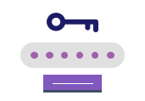

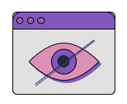
Motivation
Strong Security
Publicly Verifiable
Security by Obscurity
Low Suspicion
Attracts attention (Easily noticed)
CRYPTOGRAPHY
STEGANOGRAPHY
SECRET DATA

Slide 4




Steganography
Audio steganography
Text steganography
The art and science of hiding data within seemingly harmless messages (cover objects).
Image steganography
Video steganography

Slide 5

Video Steganography
VISUAL CHANNEL
(FRAMES / IMAGES)
AUDIO CHANNEL
(SOUND)
2 cover objects in one (higher embedding capacity). Most algorithms deal only with one channel, not both of them.

Slide 6
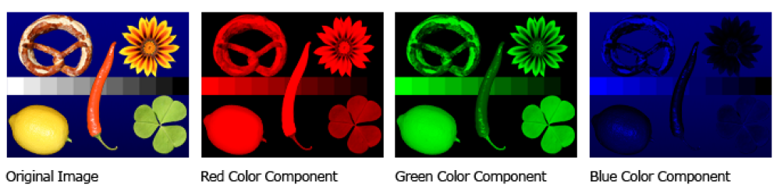
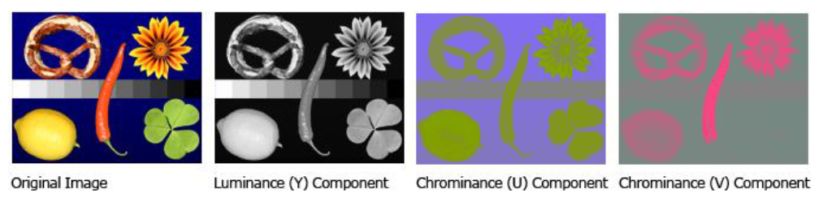
Image Steganography (Raster or bitmap images)
RGB (Red, Green, Blue)
YCbCr (Luminance, Chromatic channels)

Slide 7


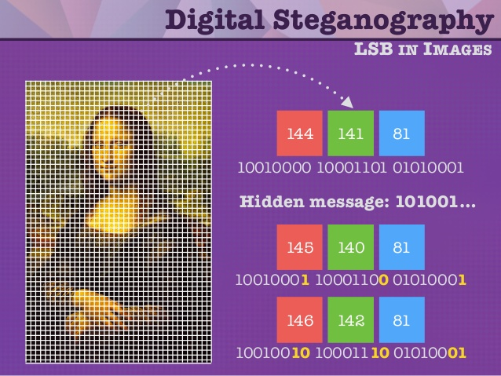
LSB (Least Significant Bit) – Spatial Domain Method
PROS
Easy to implement
Efficient
High embedding capacity
The eye is more sensitive to the luminance component, rather than the colour
Compression algorithms (JPEG) use YCbCr
CONS
Cover object cannot be altered (compressed, cropped, resized)
Does not withstand attacks (statistical or structural)
Improvements are required

Slide 8

Audio Steganography PROs and CONs over Image Steganography
MORE COMPLEX
MORE DIFFICULT
Algorithms are more robust (difficulty for attackers)
Algorithms are difficult to implement.
EAR IS MORE SENSITIVE
SAFER
Fewer steganalysis methods for audio
Even small data can be noticed in an audio.
EASILY CORRUPTED
BIGGER SIZE
Greater capacity for embedding
Audio can be easily tampered and data can be lost.

Slide 9

DCT & DWT – Transform Domain Methods
DCT
DWT
Transform audio as result of cosine functions.
Breaks audio in low and high frequencies.
Secure
Somewhat resistent to lossy compression
Less noise, very robust
Better than DCT

Slide 10
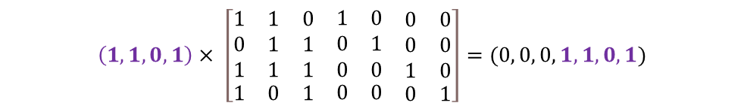
Hamming Code (4, 7)
Message
$$\left(1, 1, 0, 1\right)× \left[\begin{matrix}\begin{matrix}1 & 1 & 0 \\ 0 & 1 & 1 \\ 1 & 1 & 1\end{matrix} & \begin{matrix}1 & 0 & \begin{matrix}0 & 0\end{matrix} \\ 0 & 1 & \begin{matrix}0 & 0\end{matrix} \\ 0 & 0 & \begin{matrix}1 & 0\end{matrix}\end{matrix} \\ \begin{matrix}1 & 0 & 1\end{matrix} & \begin{matrix}0 & 0 & \begin{matrix}0 & 1\end{matrix}\end{matrix}\end{matrix}\right]=(0, 0, 0, 1, 1, 0, 1)$$
Generator Matrix
Hamming Code

Slide 11


Hamming Code (4, 7)
$$\left(0, 0, 0, 1, 1, 0, 1\right)×\left[\begin{matrix}\begin{matrix}1 & 0 \\ 0 & 1 \\ \begin{matrix}0 \\ 1 \\ 0\end{matrix} & \begin{matrix}0 \\ 1 \\ 1\end{matrix}\end{matrix} & \begin{matrix}0 \\ 0 \\ \begin{matrix}1 \\ 0 \\ 1\end{matrix}\end{matrix} \\ \begin{matrix}\begin{matrix}1 \\ 1\end{matrix} & \begin{matrix}1 \\ 0\end{matrix}\end{matrix} & \begin{matrix}1 \\ 1\end{matrix}\end{matrix}\right]=(0, 0, 0)$$
Hamming Code
Z
Check Matrix
$$\left(0, 0, 0, 1, 1, 1, 1\right)×\left[\begin{matrix}\begin{matrix}1 & 0 \\ 0 & 1 \\ \begin{matrix}0 \\ 1 \\ 0\end{matrix} & \begin{matrix}0 \\ 1 \\ 1\end{matrix}\end{matrix} & \begin{matrix}0 \\ 0 \\ \begin{matrix}1 \\ 0 \\ 1\end{matrix}\end{matrix} \\ \begin{matrix}\begin{matrix}1 \\ 1\end{matrix} & \begin{matrix}1 \\ 0\end{matrix}\end{matrix} & \begin{matrix}1 \\ 1\end{matrix}\end{matrix}\right]=(1, 1, 1)$$
Z != (0, 0, 0)
5th position
5th bit was altered

Slide 12
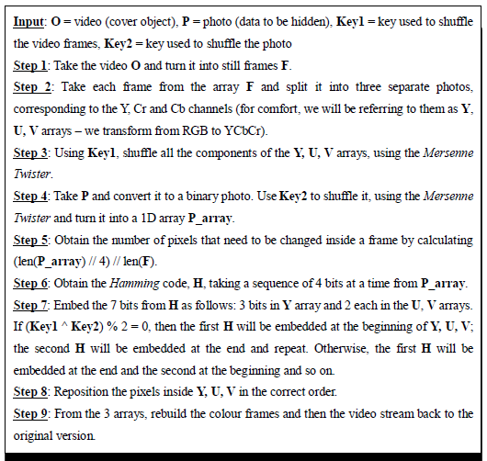
Proposed Algorithm – Visual Channel

Slide 13
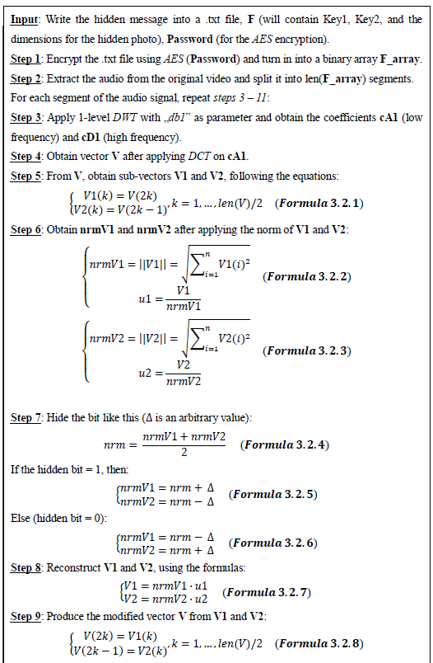
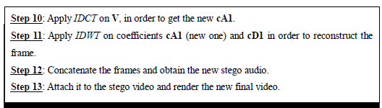
Proposed Algorithm – Audio Channel

Slide 14
Performance
Capacity
SSIM
High embedding capacity
Good values (>0,97)
[0, 1]
FUTURE
PSNR
Good values (>50)
[0, 100]
Can be extended for lossy formats in the future.
Can be extended to hide text, photos and videos.
MSE
SECURITY
Good values (<0,5)
[0, 1]
Improved security by merging steganography & cryptography and using different algorithms for the 2 channels (LSB, DCT and DWT).

Slide 15
Selective Bibliography
F. A. Peticolas, R. J. Anderson and M. G. Kuhn, “Information Hiding - A Survey”
P. Richard, “An Analysis of Steganographic Techniques”
H. Kaur and J. Rani, “A Survey on different techniques of steganography”
J. Krenn, “Steganography and Steganalysis”
F. Djebbar, B. Ayad, H. Hamam and K. Abed-Meraim, “A view on latest audio steganography techniques”
A. AlSabhany, A. H. Ali, F. Ridzuan, A. Azni and M. Mokhtar, “Digital audio steganography: Systematic review, classification, and analysis of the current state of the art”
S. Saadi, A. Merrad and A. Benziane, “Novel Secured Scheme for Blind Audio/Speech Norm-Space Watermarking by Arnold Algorithm”
M. Prunescu, “Coding Theory”
T. Sloan and J. Hernandez-Castro, “Forensic analysis of video steganography tools”
MERCURY
Mercury is the smallest and innermost planet
It’s the farthest
planet from the Sun
NEPTUNE
MARS
Despite being red, Mars is a very cold place
Venus is the second planet from the Sun
VENUS

Slide 16
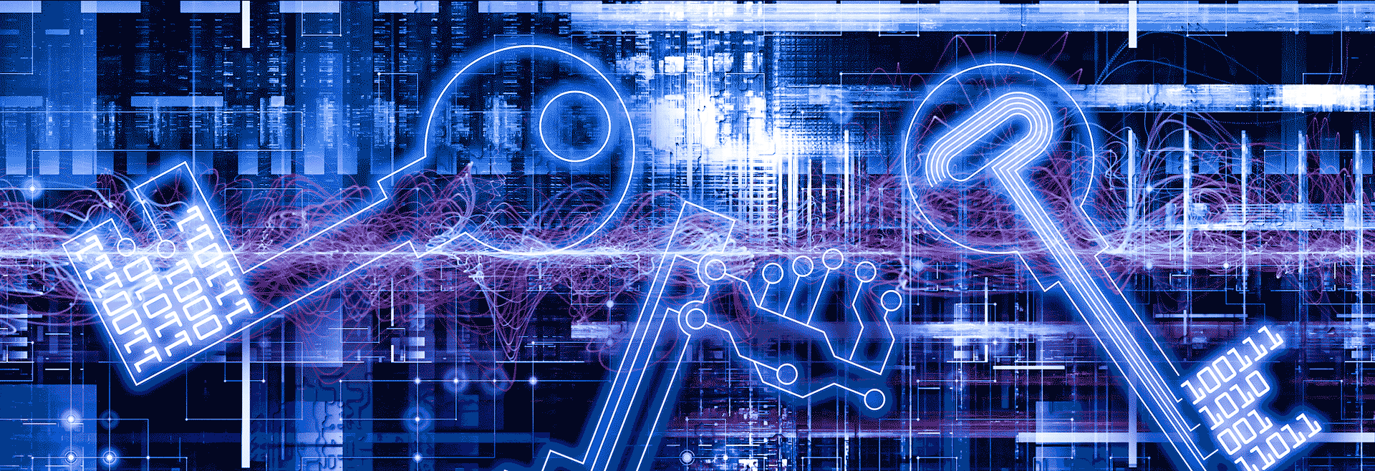
THANK YOU!

